Slide 1
6.3 Artificial intelligence
Artificial intelligence (AI)

Slide 2
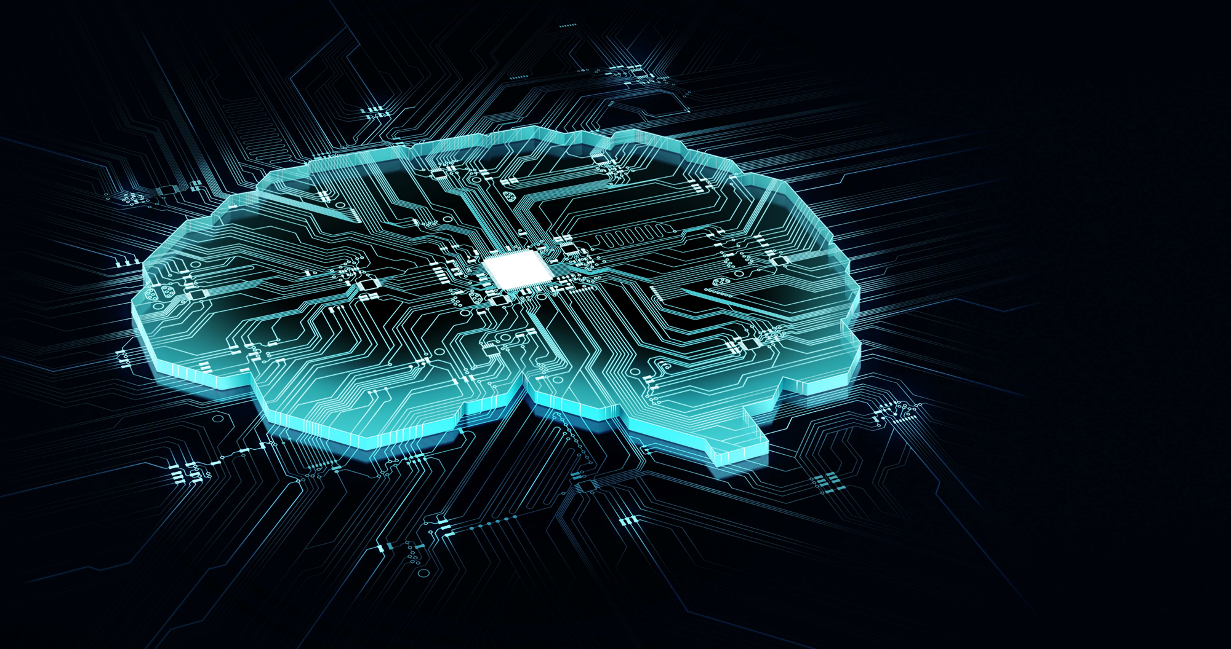
Artificial intelligence
AI is a branch of computer science dealing with the simulation of intelligent behaviours by computers.
Most AI can be broken down into two main categories:
Applied/weak/narrow AI
Most common form of AI.
Designed to manage a specific task – e.g., image recognition.
Generalised AI
Can evolve and improve to handle other tasks.
Emerging and developing area of AI closely linked to machine learning.

Slide 3








Main characteristics of artificial intelligence
In very simple terms, you can think of the main characteristics of AI as falling into the following categories:
Collection of data
Rules for using that data
Ability to reason
Ability to learn and adapt
A r t i f i c i a l I n t e l l i g e n c e
Artificial intelligence
+
Machine learning

Slide 4
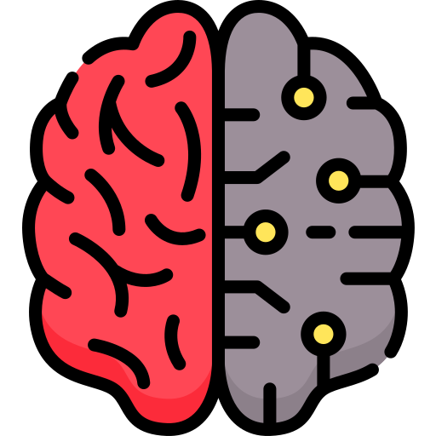
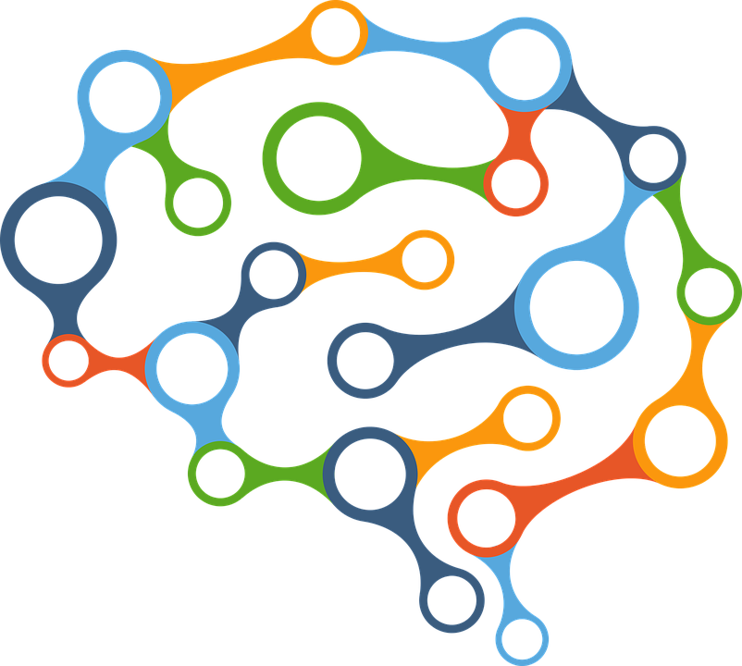


Artificial intelligence in action
Self-driving cars
Adapting revision content based on prior successes and failures
Predicting stock market trades
Alerting an operator about errors in manufacturing
Suggesting products a user might want to purchase

Slide 5

Artificial intelligence
Artificial intelligence: A broad term that describes any machine programmed to think, work and react like humans.
Applied/narrow AI is designed to manage a specific task.
Generalised AI can evolve and improve to handle other tasks.
Artificial intelligence has the following characteristics:
The ability to collect data.
A set of rules for using that data.
The ability to reason
An artificial intelligence can be described as machine learning if it possesses the ability to learn and adapt.

Slide 6


